Slide 1
Stats Yr2 Chapter 2 :: Conditional Probability
jamie@drfrostmaths.com
www.drfrostmaths.com @DrFrostMaths
Last modified: 15th November 2019

Slide 2



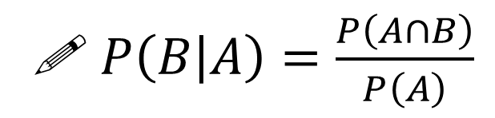



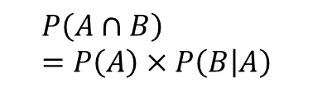


Conditional Probability
Think about how we formed a probability tree at GCSE:
?
$$P\left(A∩B\right) \\ =P\left(A\right)×P\left(B | A\right)$$
P$\left(B|A\right)$
$$B$$
?
$$P\left(A\right)$$
$$A$$
Read the ‘|’ symbol as “given that”. i.e. “B occurred given that A occurred”.
$$B′$$
$$B$$
$$A′$$
$$B′$$
Alternatively (and more commonly):
Memory Tip: You’re dividing by the event you’re conditioning on.
?
! $P\left(B | A\right)=\frac{P\left(A∩B\right)}{P\left(A\right)}$

Slide 3
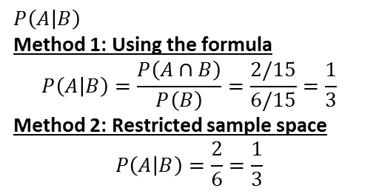
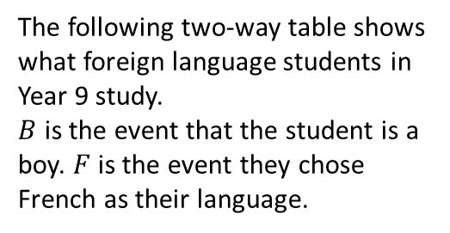






Examples
a
Determine the probability of:
$P\left(F | B^{′}\right)$
Method 1: Using the formula:
$$P\left(F | B^{′}\right)=\frac{P\left(F∩B^{′}\right)}{P\left(B^{′}\right)}=\frac{\frac{38}{100}}{\frac{60}{100}}=\frac{38}{60}$$ Method 2: Restricted sample space.
We’re finding the “probability they study French given they’re not a boy”, i.e. we’re choosing only from the non-boys:
$$P\left(F | B^{′}\right)=\frac{38}{60}$$
$P\left(B | F^{′}\right)=\frac{26}{48}$
1
The following two-way table shows what foreign language students in Year 9 study.
$B$ is the event that the student is a boy. $F$ is the event they chose French as their language.
?
?
 | $$B$$ | $$B′$$ | Total
$$F$$ | 14 | 38 | 52
$$F′$$ | 26 | 22 | 48
Total | 40 | 60 | 100
?
b
2
Using the Venn Diagram, determine:
a
$P\left(A | B\right)$
Method 1: Using the formula
$$P\left(A | B\right)=\frac{P\left(A∩B\right)}{P\left(B\right)}=\frac{2/15}{6/15}=\frac{1}{3}$$
Method 2: Restricted sample space
$$P\left(A | B\right)=\frac{2}{6}=\frac{1}{3}$$
$$ξ$$
$$A$$
$$B$$
?
?
2
3
Out of 6 things in $B$, 2 are in $A∩B$.
6
4
?
?
$P\left(A′ | B′\right)=\frac{3}{9}=\frac{1}{3} P\left(B | A∪B\right)=\frac{6}{12}=\frac{1}{2}$
b
c

Slide 4





Further Examples
Given that $P\left(A\right)=0.5$ and $P\left(A∩B\right)=0.3$, what is $P\left(B | A\right)$?
$$P\left(B | A\right)=\frac{P\left(A∩B\right)}{P\left(A\right)}=\frac{0.3}{0.5}=0.6$$
Given that $P\left(Y\right)=0.6$ and $P\left(X∩Y\right)=0.4$, what is $P\left(X^{′} | Y\right)$? (Hint: Drawing a Venn Diagram will help!)
$P\left(X^{′} | Y\right)=\frac{P\left(X^{′}∩Y\right)}{P\left(Y\right)}$ $∴P\left(X^{′} | Y\right)=\frac{0.2}{0.6}=\frac{1}{3}$
Given that $P\left(A\right)=0.5$, $P\left(B\right)=0.5$ and $P\left(A∩B\right)=0.4$, what is $P\left(B | A^{′}\right)$?
$$P\left(B | A^{′}\right)=\frac{P\left(A^{′}∩B\right)}{P\left(A^{′}\right)} \\ =\frac{0.1}{0.5}$$
$$=0.2$$
a
Fro Tip: The ‘restricted sample space’ method also works for Venn Diagrams with probabilities.
?
b
?
$$X$$
$$Y$$
0.4
0.2
c
?
$$A$$
$$B$$
0.1
0.4
0.1
0.4

Slide 5

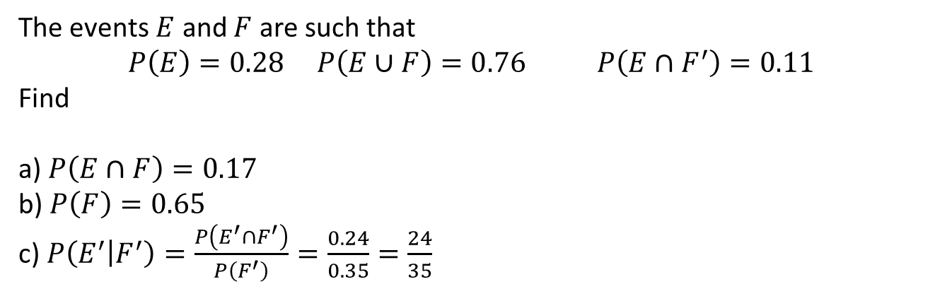


Check your understanding
The events $E$ and $F$ are such that
$$P\left(E\right)=0.28 P\left(E∪F\right)=0.76 P\left(E∩F^{′}\right)=0.11$$
Find
a) $P\left(E∩F\right)=0.17$
b) $P\left(F\right)=0.65$
c) $P\left(E^{′} | F^{′}\right)=\frac{P\left(E^{′}∩F^{′}\right)}{P\left(F^{′}\right)}=\frac{0.24}{0.35}=\frac{24}{35}$
?
?
?
Click to reveal Venn Diagram
$$ξ$$
$$E$$
$$F$$
0.11
0.17
0.48
0.24

Slide 6
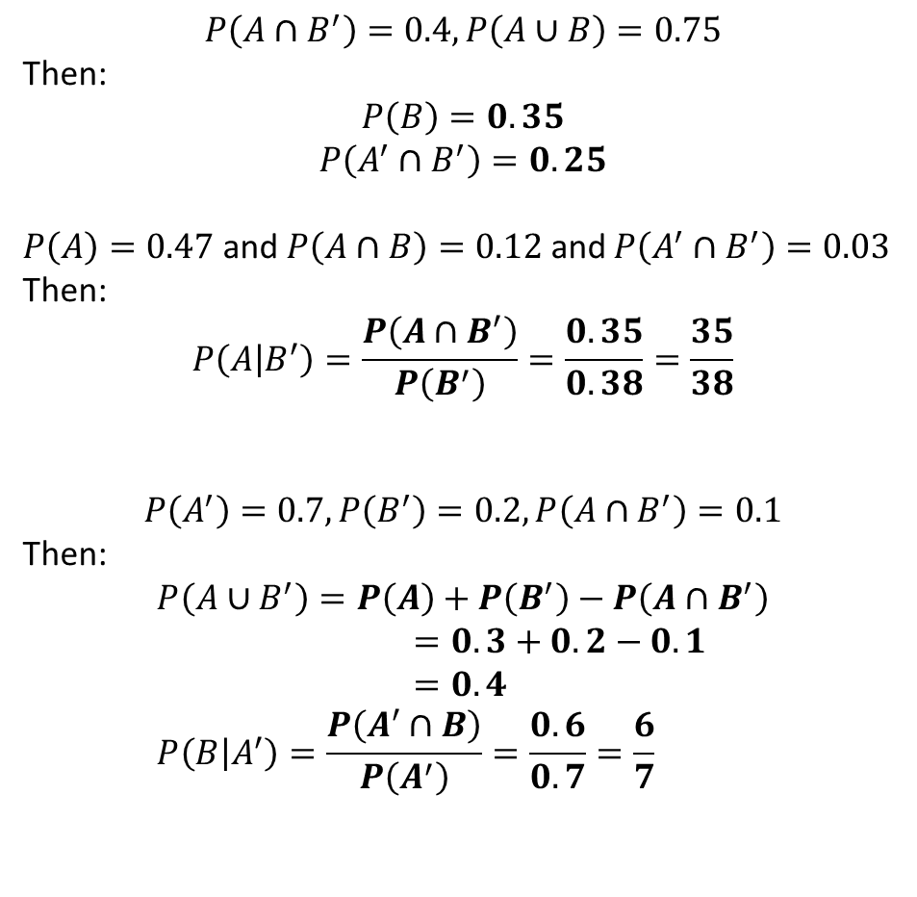
Further Practice (outside of class)
1
$$P\left(A∩B^{′}\right)=0.4, P\left(A∪B\right)=0.75$$
Then:
$$P\left(B\right)=0.35$$
$$P\left(A^{′}∩B^{′}\right)=0.25$$
$P\left(A\right)=0.47$ and $P\left(A∩B\right)=0.12$ and $P\left(A^{′}∩B^{′}\right)=0.03$
Then:
$$P\left(A | B^{′}\right)=\frac{P\left(A∩B^{′}\right)}{P\left(B^{′}\right)}=\frac{0.35}{0.38}=\frac{35}{38}$$
$$P\left(A^{′}\right)=0.7, P\left(B^{′}\right)=0.2, P\left(A∩B^{′}\right)=0.1$$
Then:
$$P\left(A∪B^{′}\right)=P\left(A\right)+P\left(B^{′}\right)−P\left(A∩B^{′}\right) \\ =0.3+0.2−0.1 \\ =0.4 \\ P\left(B | A^{′}\right)=\frac{P\left(A^{′}∩B\right)}{P\left(A^{′}\right)}=\frac{0.6}{0.7}=\frac{6}{7}$$
?
?
2
?
3
?
?

Slide 7
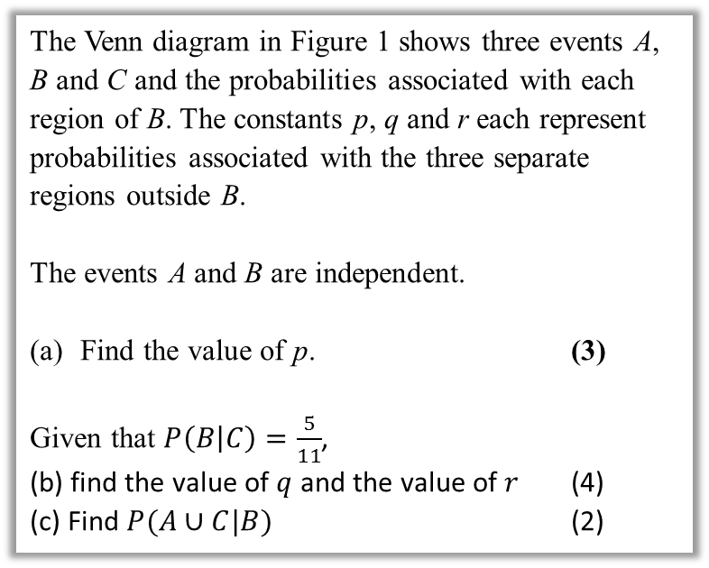

Further Test Your Understanding
May 2013 (R) Q6
(From earlier) $0.1=\left(p+0.1\right)×0.4$ $p+0.1=0.25$ $p=0.15$
$P\left(B | C\right)=\frac{P\left(B∩C\right)}{P\left(C\right)}$ $\frac{5}{11}=\frac{0.2}{0.2+q}$ $q=0.24$ $r=1−0.15−0.1−0.1−0.2−0.24$ $=0.21$
$P\left(A∪C | B\right)=\frac{P\left(\left(A∪C\right)∩B\right)}{P\left(B\right)}$ $=\frac{0.1+0.2}{0.4}=0.75$
?
The Venn diagram in Figure 1 shows three events A, B and C and the probabilities associated with each region of B. The constants p, q and r each represent probabilities associated with the three separate regions outside B.
The events A and B are independent.
Find the value of p. (3)
Given that $P\left(B | C\right)=\frac{5}{11}$,
(b) find the value of $q$ and the value of $r$ (4)
(c) Find $P(A∪C|B)$ (2)
?

Slide 8

Exercise 2C
Pearson Stats/Mechanics Year 2
Pages 25-27
Note: I have skipped Exercise 2B.
Extension:
[Classic puzzle] I have 2 children. One of them is a boy. What’s the probability the other is a boy?
If (at least) one is a boy, restricted sample space is BB, BG, GB. Of these, only in one case is the other a boy. $∴\frac{1}{3}$
1
?

Slide 9
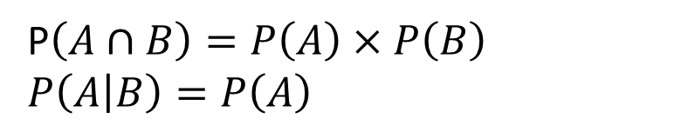
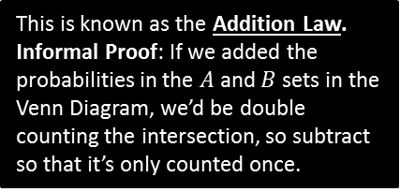
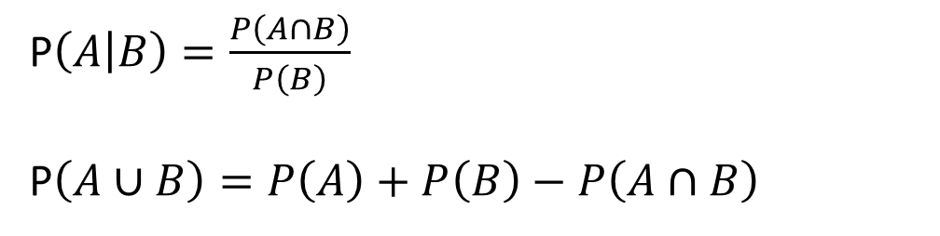
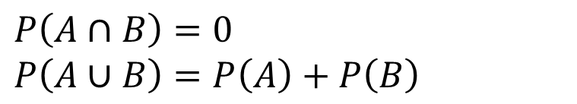
Full Laws of Probability
!
If events $A$ and $B$ are independent.
?
P$\left(A∩B\right)=P\left(A\right)×P\left(B\right)$
$P\left(A | B\right)=P\left(A\right)$
?
If events $A$ and $B$ are mutually exclusive:
?
$P\left(A∩B\right)=0$
$P\left(A∪B\right)=P\left(A\right)+P\left(B\right)$
?
In general:
We first encountered this in the previous section.
?
P$\left(A | B\right)=\frac{P\left(A∩B\right)}{P\left(B\right)}$
P$\left(A∪B\right)=P\left(A\right)+P\left(B\right)−P\left(A∩B\right)$
This is known as the Addition Law.
Informal Proof: If we added the probabilities in the $A$ and $B$ sets in the Venn Diagram, we’d be double counting the intersection, so subtract so that it’s only counted once.
?

Slide 10
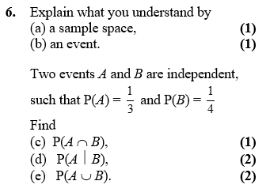
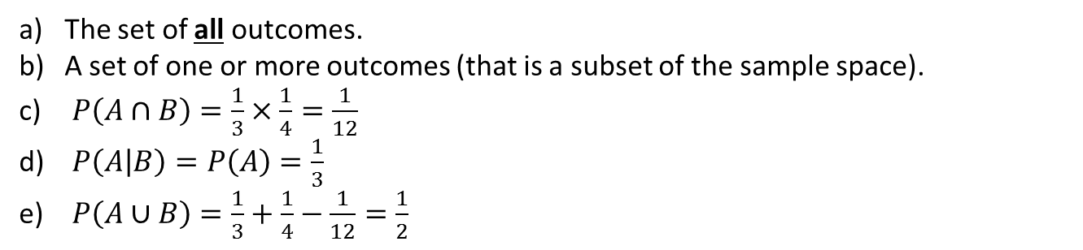
Example
Edexcel S1
?
The set of all outcomes.
A set of one or more outcomes (that is a subset of the sample space).
$P\left(A∩B\right)=\frac{1}{3}×\frac{1}{4}=\frac{1}{12}$
$P\left(A | B\right)=P\left(A\right)=\frac{1}{3}$
$P\left(A∪B\right)=\frac{1}{3}+\frac{1}{4}−\frac{1}{12}=\frac{1}{2}$
?
?
?
?

Slide 11
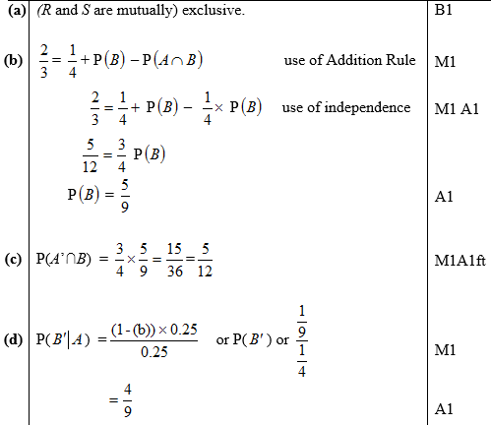
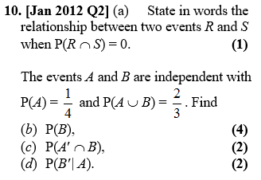

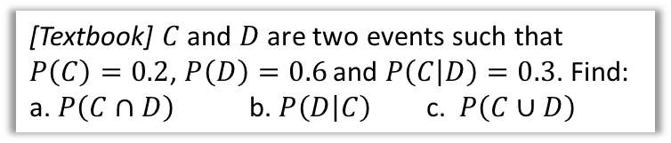
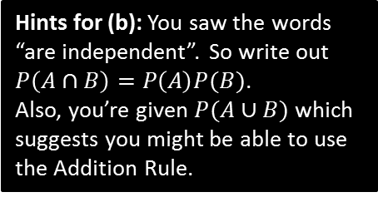
Further Examples
Hints for (b): You saw the words “are independent”. So write out $P\left(A∩B\right)=P\left(A\right)P(B)$.
Also, you’re given $P(A∪B)$ which suggests you might be able to use the Addition Rule.
[Textbook] $C$ and $D$ are two events such that $P\left(C\right)=0.2$, $P\left(D\right)=0.6$ and $P\left(C | D\right)=0.3$. Find:
a. $P\left(C∩D\right)$ b. $P\left(D | C\right)$ c. $P\left(C∪D\right)$
? a
$$P\left(C | D\right)=\frac{P\left(C∩D\right)}{P\left(D\right)} → 0.3=\frac{P\left(C∩D\right)}{0.6} \\ P\left(C∩D\right)=0.18$$
$$P\left(D | C\right)=\frac{P\left(C∩D\right)}{P\left(C\right)}=\frac{0.18}{0.2}=0.9$$
$$P\left(C∪D\right)=P\left(C\right)+P\left(D\right)−P\left(C∩D\right) \\ =0.2+0.6−0.18=0.62$$
?
? b
?
? c
?
?

Slide 12
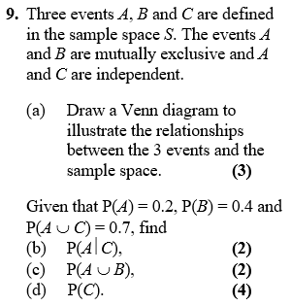





Test Your Understanding
Edexcel S1
a)
?
$$ξ$$
$$C$$
$$A$$
$$B$$
b) $P\left(A | C\right)=P\left(A\right)=0.2$
c) $P\left(A∪B\right)=P\left(A\right)+P\left(B\right)=0.6$
d) $P\left(A∪C\right)=P\left(A\right)+P\left(C\right)−P\left(A∩C\right)$ $$0.7=0.2+P\left(C\right)−0.2P\left(C\right) \\ 0.5=0.8P\left(C\right) \\ P\left(C\right)=\frac{5}{8}$$
?
?
?

Slide 13

SUPER IMPORTANT TIPS
If I were to identify two tips that will possible help you the most in probability questions:
If you see the words ‘given that’, Immediately write out the law for conditional probability.
Example: “Given Bob walks to school, find the probability that he’s not late…”
?
First thing you should write: $P\left(L^{′} | W\right)=\frac{P\left(L^{′}∩W\right)}{P\left(W\right)}=…$
If you see the words ‘are independent’, Immediately write out the laws for independence.
(Even before you’ve finished reading the question!)
Example: “$A$ is independent from $B$…”
?
First thing you should write: $P\left(A∩B\right)=P\left(A\right)P\left(B\right)$ $$P\left(A | B\right)=P(A)$$
If you’re stuck on a question where you have to find a probability given others, it’s probably because you’ve failed to take into account that two events are independent or mutually exclusive, or you need to use the conditional probability or additional law.

Slide 14
Exercise 2D
Pearson Stats/Mechanics Year 2
Pages 29-30

Slide 15
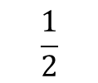
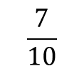


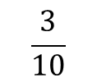


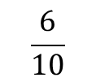

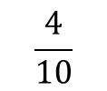

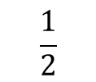

Probability Trees
We saw probability trees in Year 1. The only difference here is determining a conditional probability using your tree.
Example: You have two bags, the first with 5 red balls and 5 blue balls, and the second with 3 red balls and 6 blue balls. You first pick a ball from the first bag, and place it in the second. You then pick a ball from the second bag. Complete the tree diagram.
Hence find the probability that:
You pick a red ball on your second pick. $P\left(R_{2}\right)=P\left(R_{1}∩R_{2}\right)+P\left(B_{1}{∩R}_{2}\right)=\frac{1}{5}+\frac{3}{20}=\frac{7}{20}$
Given that your second pick was red, the first pick was also red. $P\left(R_{1} | R_{2}\right)=\frac{P\left(R_{1}∩R_{2}\right)}{P\left(R_{2}\right)}$ $=\frac{\frac{1}{5}}{\frac{7}{20}}=\frac{4}{7}$
$$\frac{4}{10}$$
?
$$R_{2}$$
?
?
$$\frac{1}{2}$$
$$R_{1}$$
$$\frac{6}{10}$$
?
$$B_{2}$$
?
$$\frac{3}{10}$$
$$R_{2}$$
$$\frac{1}{2}$$
?
$$B_{1}$$
?
$$\frac{7}{10}$$
?
$$B_{2}$$
It’s vitally important that you use good notation, making use of the | symbol.
Fro Tip: Use variable subscripting to indicate what pick you’re referring to.

Slide 16
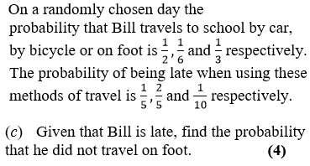
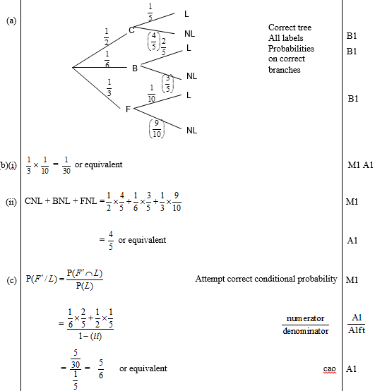
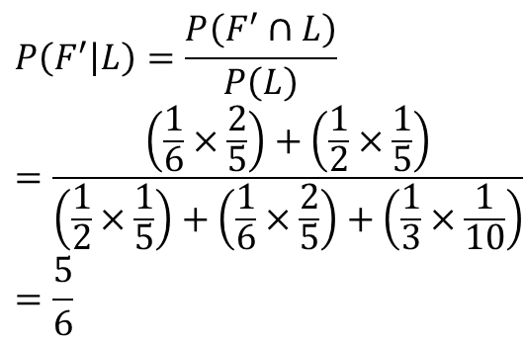
Further Example
Edexcel S1 May 2009 Q2
(Part (a) asks for a tree diagram, which may help with this question)
?
$$P\left(F^{′} | L\right)=\frac{P\left(F^{′}∩L\right)}{P\left(L\right)} \\ =\frac{\left(\frac{1}{6}×\frac{2}{5}\right)+\left(\frac{1}{2}×\frac{1}{5}\right)}{\left(\frac{1}{2}×\frac{1}{5}\right)+\left(\frac{1}{6}×\frac{2}{5}\right)+\left(\frac{1}{3}×\frac{1}{10}\right)} \\ =\frac{5}{6}$$

Slide 17
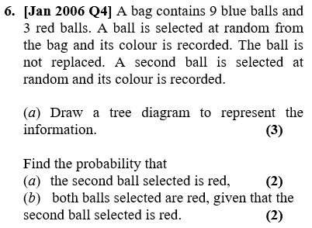
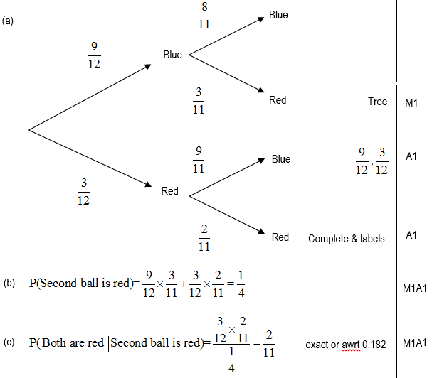
Testing Your Understanding
Edexcel S1
?
?
?

Slide 18
Exercise 2E
Pearson Stats/Mechanics Year 2
Pages 31-34

